Slide 1
2021 Spirit
Rules
Shawn Knight – NFHS Spirit Committee Chair
Shaunda Brown – NFHS Spirit Rules Interpreter
James Weaver – NFHS Director of Performing Arts and Sports

Slide 2
2021 Rules Changes

Slide 3
Rule 2-1-21 Religious head coverings
Adjusted language to allow head coverings for religious reasons without state association approval.

Slide 4
3-2-1b 4-2-1b Stunting Personnel
A base must not:
a. Assume a back-bend, headstand, or handstand position
b. Hold objects in a hand that is supporting a top person.
Exception: A base and top person may share a pom during a dismount from a thigh stand, shoulder sit/straddle, shoulder stand, or prep.
Rationale: The exemption clarifies the current interpretation of rules 3-2-1 and 4-2-1.

Slide 5
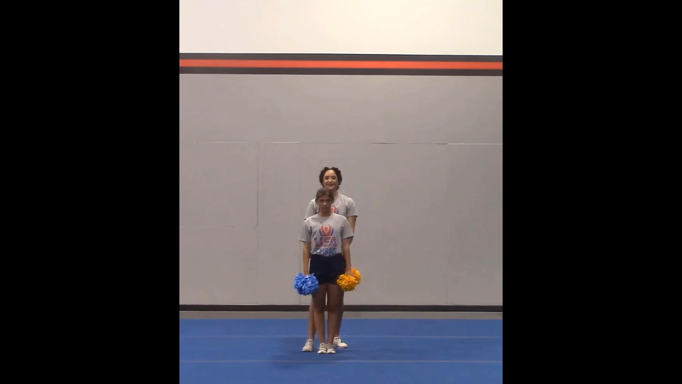

Slide 6
3-3-3 Inversions
Delete sub-rule C.
c. The top person and at least one bracer maintains hand-to-hand/arm contact.
Rationale: Requiring hand-to-hand/arm contact may put the top person in a less than ideal position by having to force a connection with an arm instead of using the same technique they would if there were no bracer. This change would allow for common methods to be taught for common skills and lower the risk of injury.
Notes:
Comment-The criteria of how the top person should be caught is in the rule (3.3.6c) and not the definition.

Slide 7
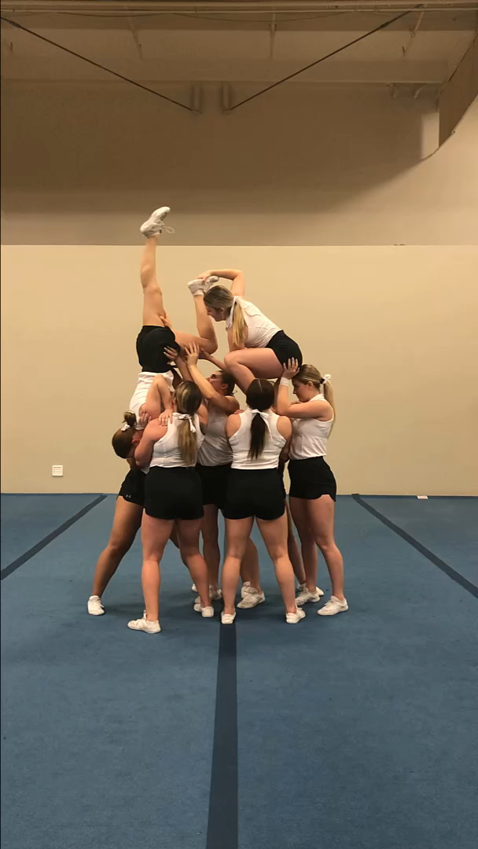

Slide 8
Rule 3-3-6d Suspended Stunts (Deleted)
d. When the stunt begins in an inversion and transitions to a non-inverted position, the upper body contact may be released before the top person is no longer inverted.
Rationale: No longer needed after 2020 rule changes discontinued the requirement for upper body contact.

Slide 9
Rule 3-5-5c Release Stunts/tosses
c. The top person and at least one bracer maintain hand-to-hand/arm contact except for the following skills:
If the release is to a cradle position, the contact may be hand-to-foot and the bracer must be in a double-based prep with a spotter.
Rationale: Allows the hand-to-foot release to land back in a skill or other position besides a cradle. This will allow for a cleaner rule and interpretation without increasing the risk of injury.

Slide 10
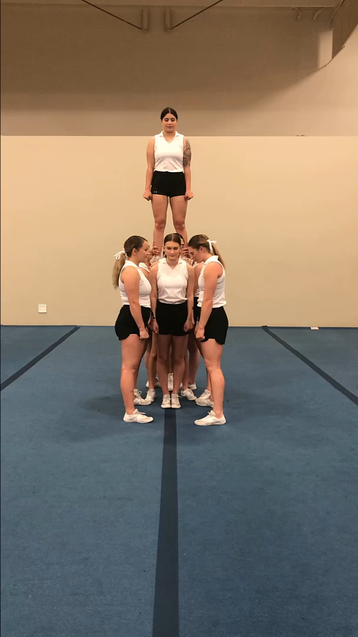

Slide 11
Rule 4-2-8 Stunting Personnel
A spotter is required for tosses to single-base prep-level stunts in which the foot/feet of the top person is in the hands of the base and for tosses to single-base shoulder stands.
Rationale: Clarifies that a spotter is required anytime the feet of the top person are in the hands of a base or during the toss portion of a toss to shoulder stand. Mirrors the language in 3-2-8.
Notes:
Comment- This rule change allows the base of a non-extended stunt to hand or take a sign or prop to or from a top person with a hand that is not supporting a top person.

Slide 12
2021 Points of emphasis

Slide 13
Return to Play/activity
The NFHS continues to focus on the health and safety of all participants. Consideration should be taken into account whether at the beginning of the season or after an extended absence from the activity. This would include but not limited to mental, physical and emotional preparedness of the participant. Emphasis should be given to strength and conditioning, skill progressions, state association return to play protocols and any state and local guidelines. Further risk minimization would also include being mindful of the potential of overuse injuries due to extended practices, performances and competitions.

Slide 14
You must complete the rules attendance form to receive credit.
Click the link below. If you are not playing the slide show,
you will have to copy the link and paste it in your browser.
https://www.cognitoforms.com/MississippiHighSchoolActivitiesAssociation/RulesClinicAttendanceForm

